Slide 1


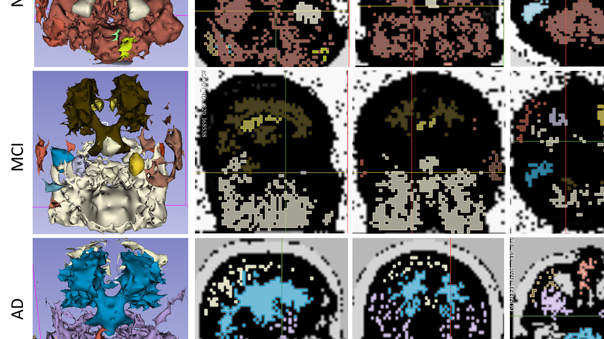



MRI segmentation by HDBSCAN

Slide 2
MRI information
NL (male):
PTID: 073_S_0089
The image code S11161_I119227
MCI (male):
PTID: 037_S_0539
The image code S25820_I68538
AD (male):
PTID: 020_S_0213
The image code S22879_I60609

Slide 3
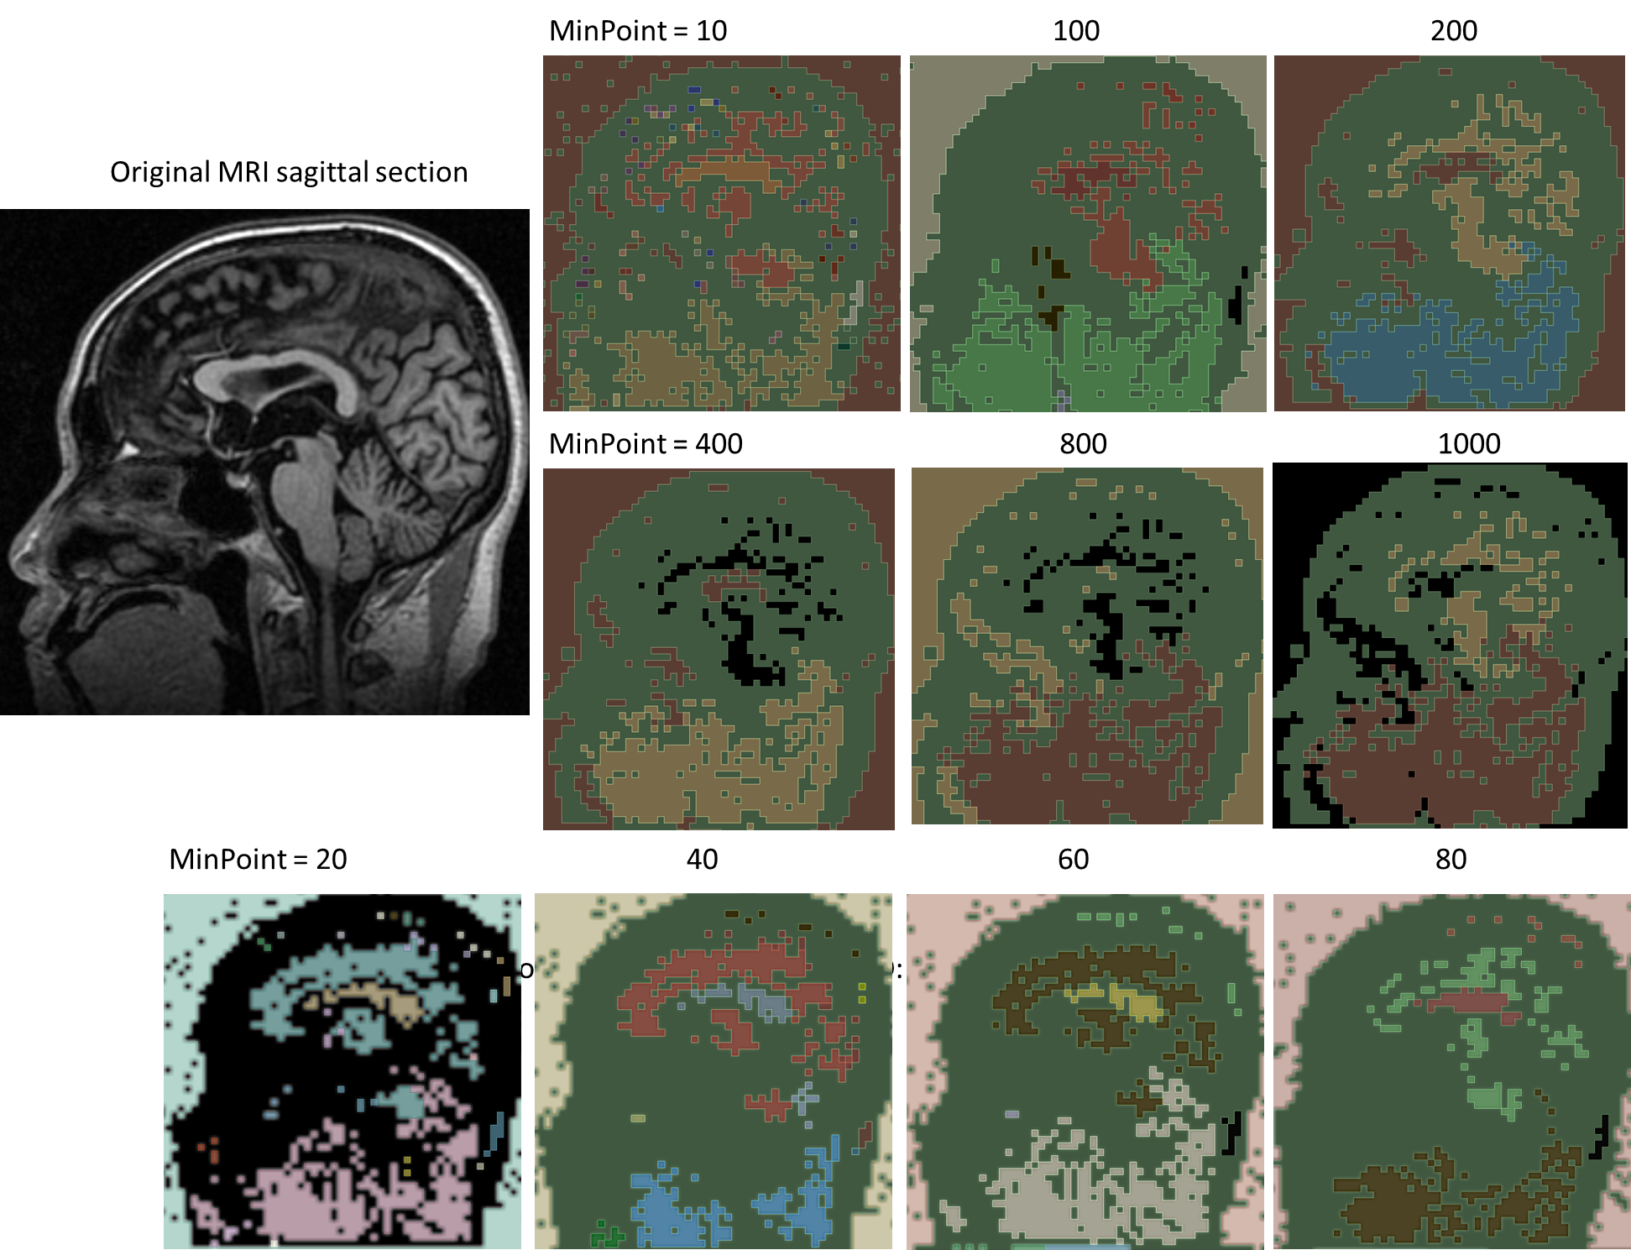
HDBSCAN Parameter tuning
Resolution: 64 x 64 x 64
MinPoint: minimum number of neighbors to a core point

Slide 4
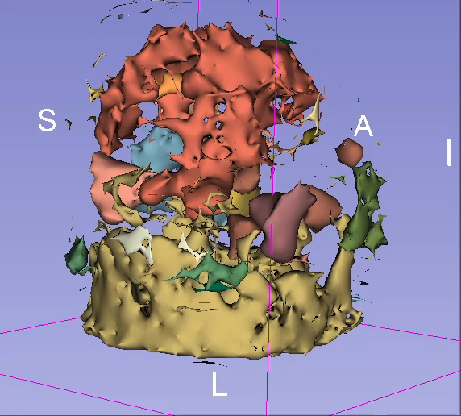
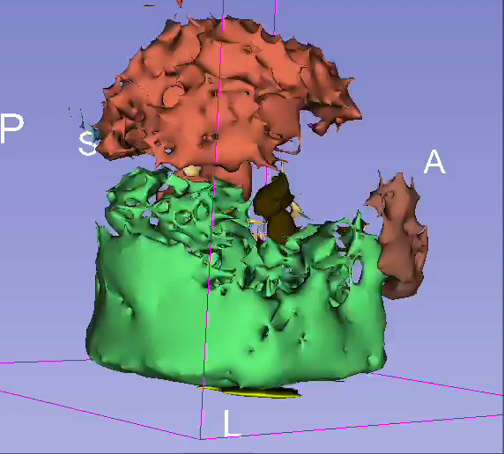
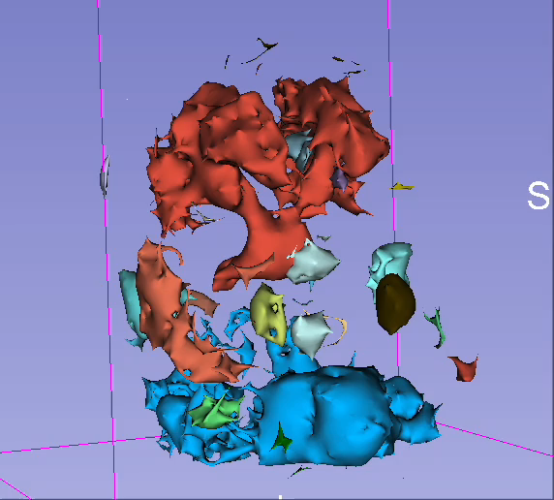
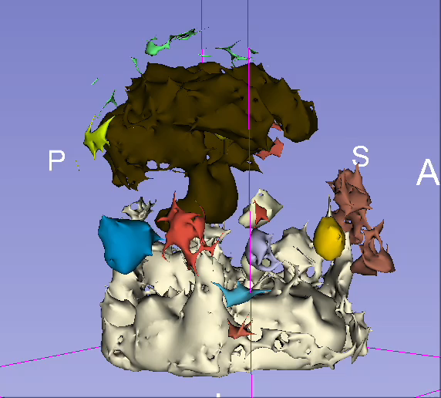
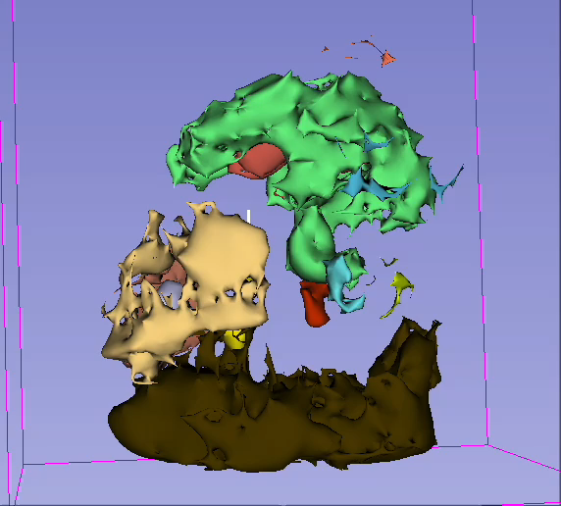
HDBSCAN Parameter tuning
Resolution: 64 x 64 x 64
MinPoint: minimum number of neighbors to a core point

Slide 5
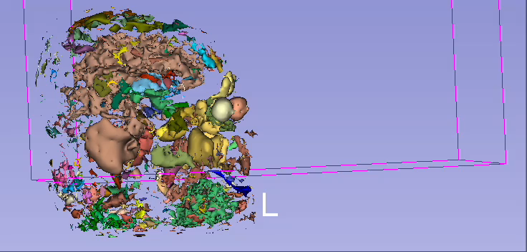
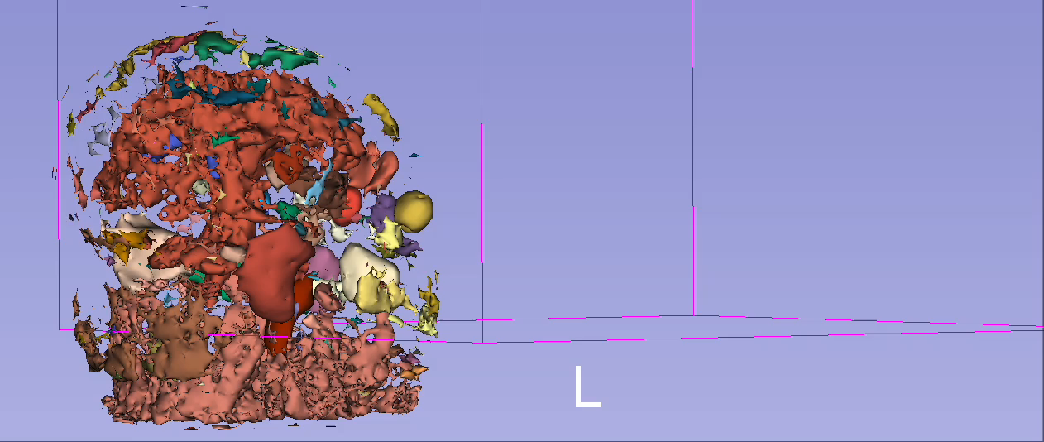
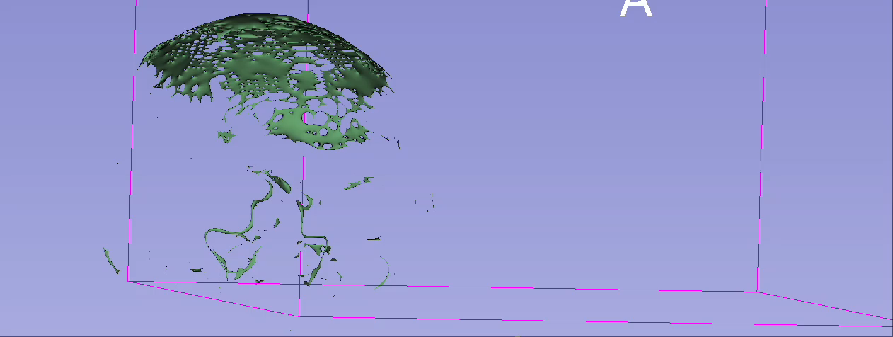
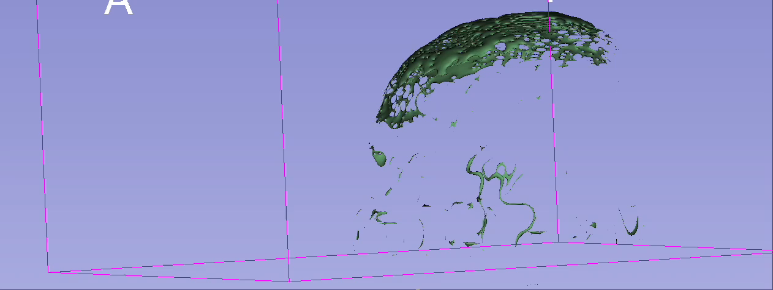
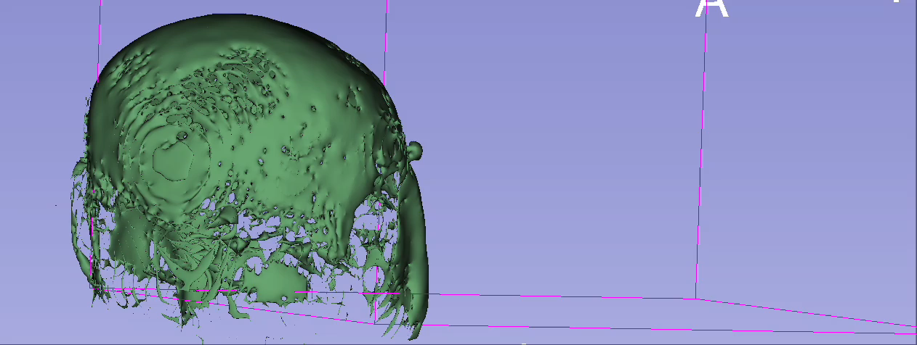
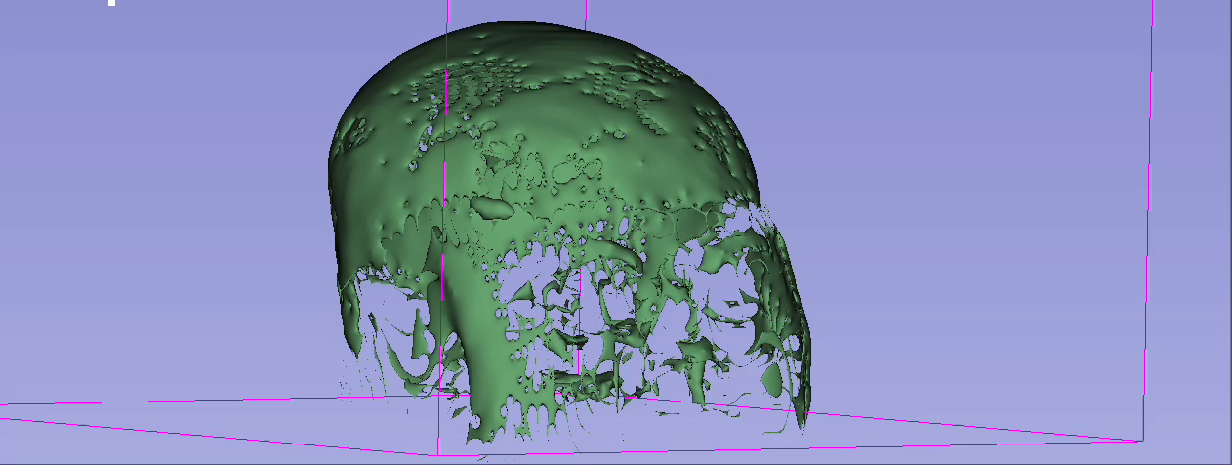
HDBSCAN Parameter tuning
MinPoint = 20 MinPoint= 30
Resolution:
128 x 128 x 128
MinPoint = 40 MinPoint= 50
MinPoint = 100 MinPoint= 200

Slide 6
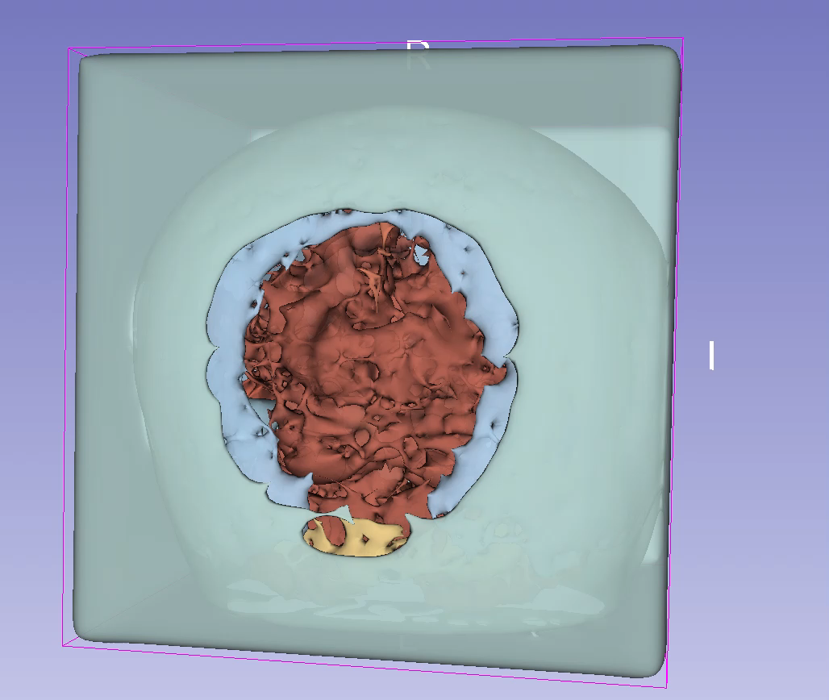
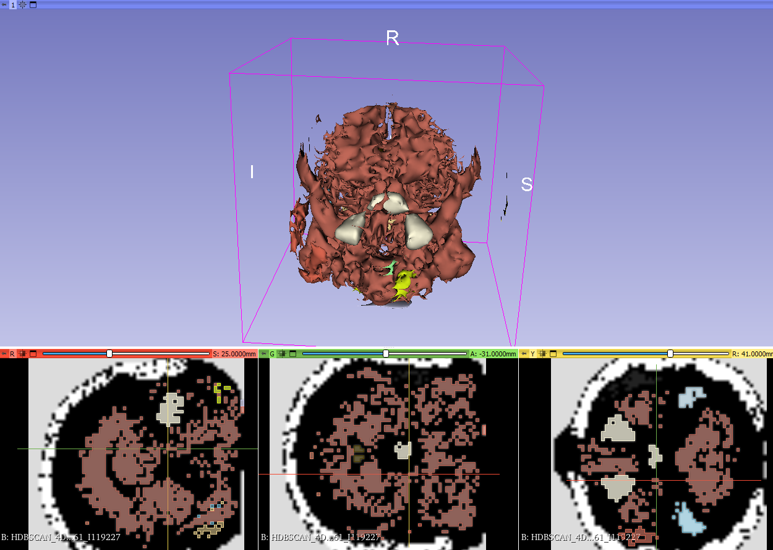
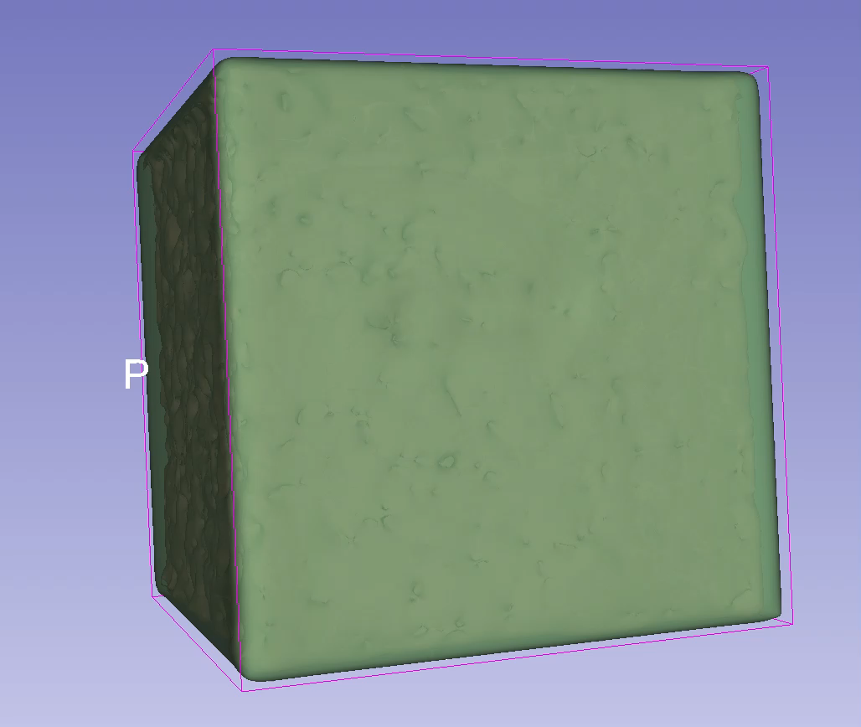
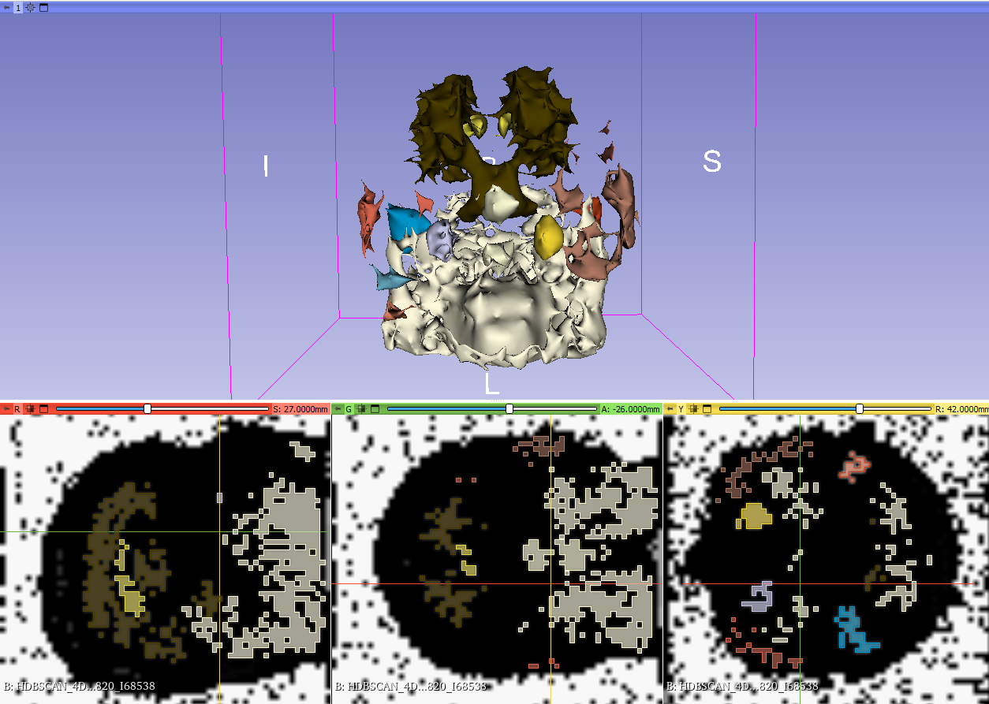
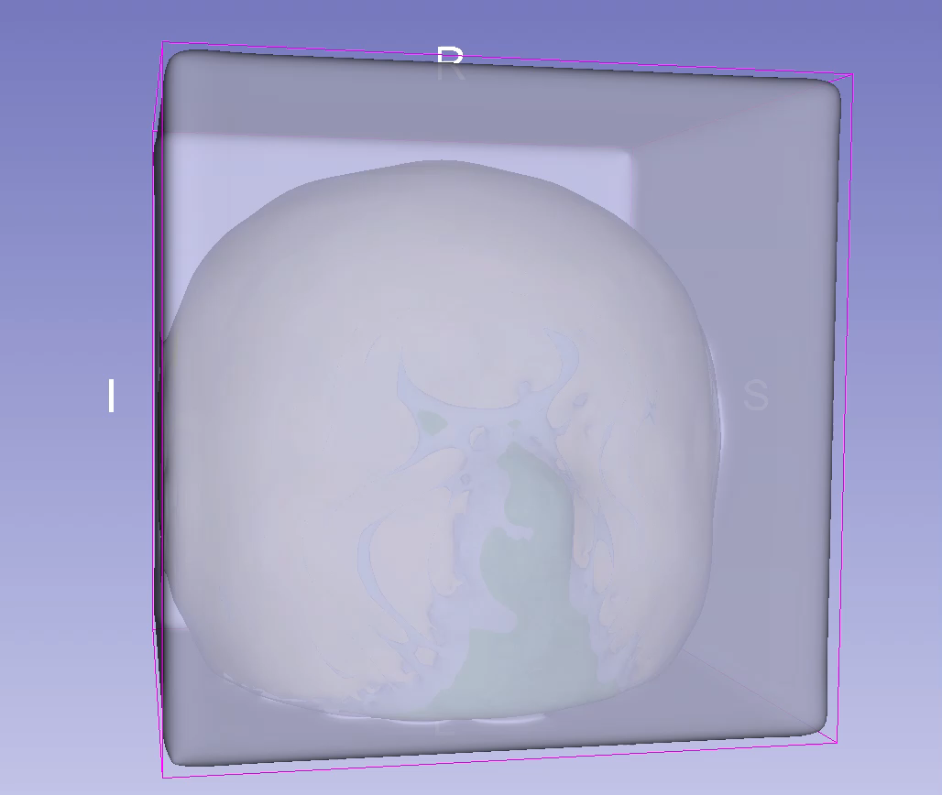
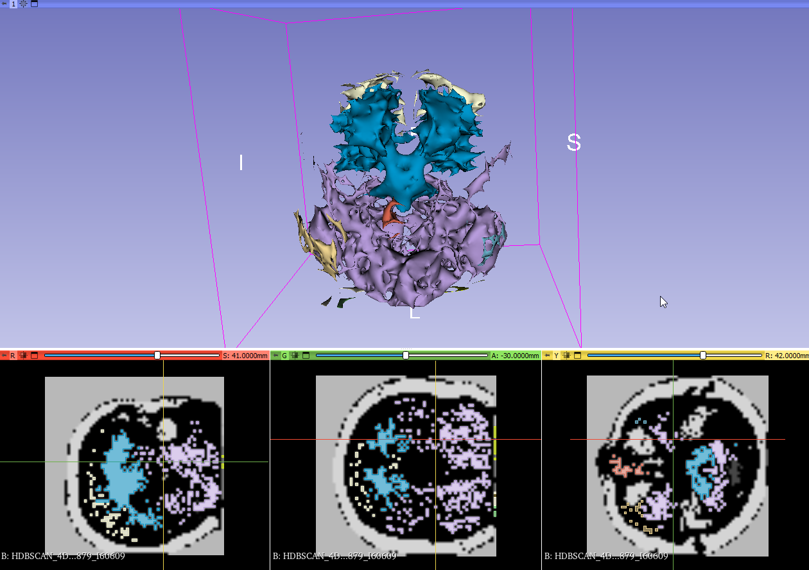
Results
3D Sagittal Coronal Horizontal
Resolution: 64 x 64 x 64
AD MCI NL
6

